Slide 1
File System

Slide 2
File-System Structure
File structure
Logical storage unit
Collection of related information
File system resides on secondary storage (disks)
Provided user interface to storage, mapping logical to physical
Provides efficient and convenient access to disk by allowing data to be stored, located retrieved easily
Disk provides in-place rewrite and random access
I/O transfers performed in blocks of sectors (usually 512 bytes)
File control block (FCB) – storage structure consisting of information about a file
Device driver controls the physical device
File system organized into layers

Slide 3
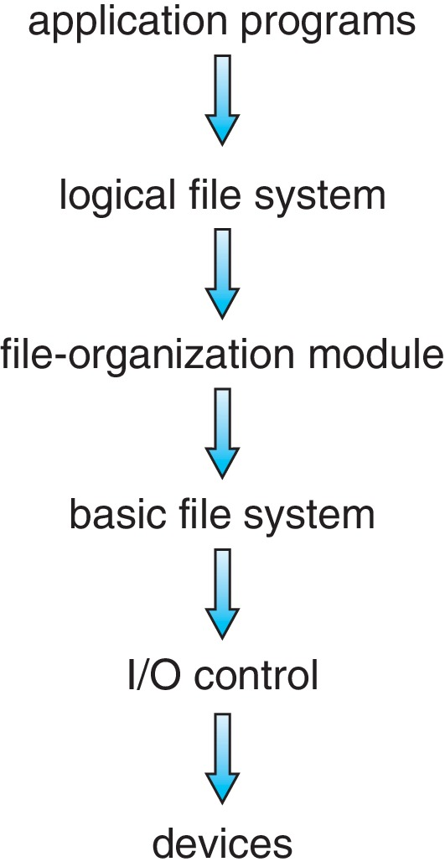
Layered File System

Slide 4
File System Layers
Device drivers manage I/O devices at the I/O control layer
Given commands like “read drive1, cylinder 72, track 2, sector 10, into memory location 1060” outputs low-level hardware specific commands to hardware controller
Basic file system given command like “retrieve block 123” translates to device driver
Also manages memory buffers and caches (allocation, freeing, replacement)
Buffers hold data in transit
Caches hold frequently used data
File organization module understands files, logical address, and physical blocks
Translates logical block # to physical block #
Manages free space, disk allocation

Slide 5
File System Layers
Logical file system manages metadata information
Translates file name into file number, file handle, location by maintaining file control blocks (inodes in UNIX)
Directory management
Protection
Layering useful for reducing complexity and redundancy, but adds overhead and can decrease performance.
Logical layers can be implemented by any coding method according to OS designer

Slide 6
File-System Operations
We have system calls at the API level, but how do we implement their functions?
On-disk and in-memory structures
Boot control block contains info needed by system to boot OS from that volume
Needed if volume contains OS, usually first block of volume
Volume control block (superblock, master file table) contains volume details
Total # of blocks, # of free blocks, block size, free block pointers or array
Directory structure organizes the files
Names and inode numbers, master file table

Slide 7
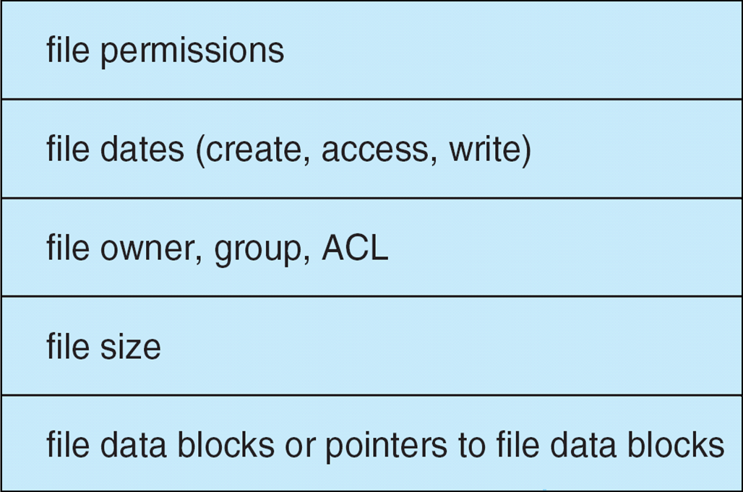
File-System Implementation
Per-file File Control Block (FCB) contains many details about the file
Typically inode number, permissions, size, dates
NFTS stores into in master file table using relational DB structures

Slide 8
Directory Implementation
Linear list of file names with pointer to the data blocks
Simple to program
Time-consuming to execute
Linear search time
Could keep ordered alphabetically via linked list.
Hash Table – linear list with hash data structure
Decreases directory search time
Collisions – situations where two file names hash to the same location
Only good if entries are fixed size, or use chained-overflow method

Slide 9
Allocation Methods - Contiguous
An allocation method refers to how disk blocks are allocated for files:
Each file occupies set of contiguous blocks
Best performance in most cases
Simple – only starting location (block #) and length (number of blocks) are required
Problems include:
Finding space for file,
Knowing file size,
External fragmentation, need for compaction off-line (downtime) or on-line

Slide 10
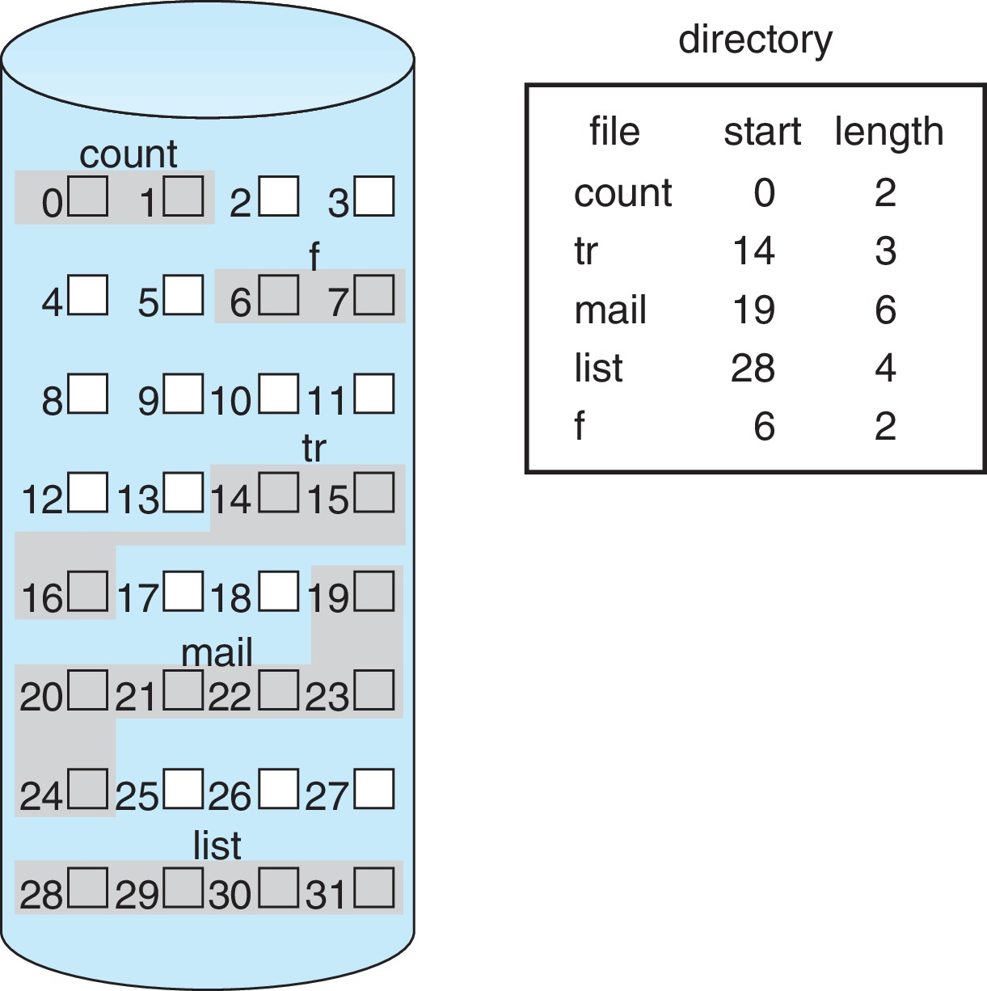
Contiguous Allocation
Mapping from logical to physical (block size =512 bytes)
Block to be accessed = starting address + Q
Displacement into block = R
Q
LA/512
R

Slide 11
Allocation Methods - Linked
Each file a linked list of blocks
File ends at nil pointer
No external fragmentation
Each block contains pointer to next block
No compaction, external fragmentation
Free space management system called when new block needed
Improve efficiency by clustering blocks into groups but increases internal fragmentation
Reliability can be a problem
Locating a block can take many I/Os and disk seeks.

Slide 12
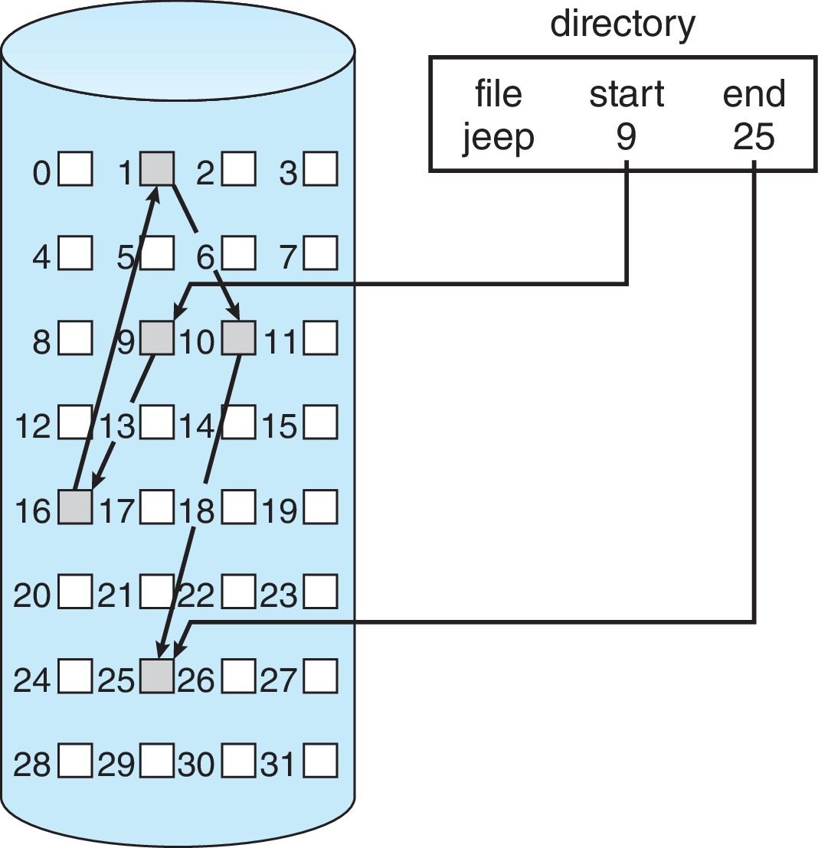
Linked Allocation
Each file is a linked list of disk blocks: blocks may be scattered anywhere on the disk
Scheme

Slide 13
Linked Allocation
Mapping
Block to be accessed is the Q^{th} block in the linked chain of blocks representing the file.
Displacement into block = R + 1
Q
LA/511
R

